Slide 1
EDA on News article dataset

Slide 2

Objective What we want to accomplish
Business Objective
How can we improve article popularity?
Data Science Objective
What are the most important predictors for popularity

Slide 3
Data Overview What we are working with
Urltoimage | Contains a URL to the main image associated with the article.
Source_name | Contains publisher name.
Author | Contains article author. Some publishers do not share information about authors of their news, in this case usually source_name replaces that information
Title | Contains headline of an article.
Sourceid | Contains publisher unique identifier usually presented as lowercase sourcename with spaces replaced with hypen symbol.
Description | Contains short article description usually visible in popups or recommendation boxes on the publisher's website. This field is shortened to a few sentences content column.
Url | Contains URL (Uniform Resource Locator) for article located on the publisher website.

Slide 4
Data Overview What we are working with
Published_at | Contains the exact date and time of publishing the article. Date and time are presented in UTC (+000) time format
Content | Contains the unformatted content of the article. This field is truncated to 260 characters
Top_article | Contains article listed as a top article on publisher website. This field can have only two values, 1 when the article is contained in the popular/top articles group and 0 otherwise
total_comments | Contains count of total comments on article
total_shares | Contains count the number of time article was share
total_plugin_comments | Contains count of plugin comments
total_reactions | Contains count of reactions on the article

Slide 5
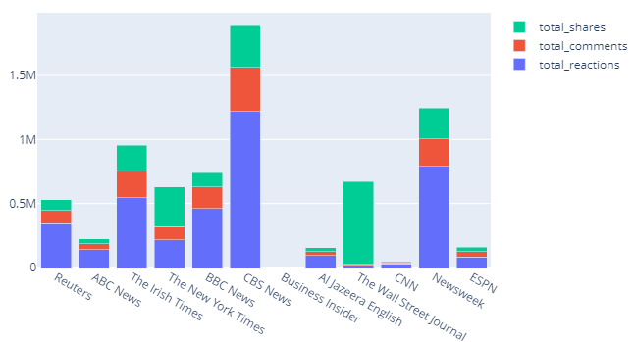
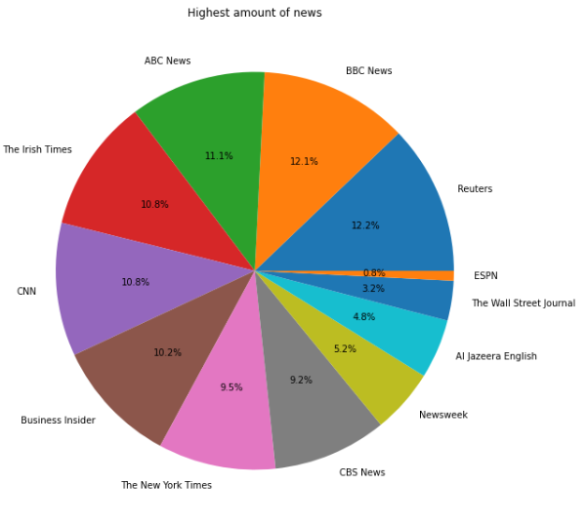
EDA-Source
Source is a strong predictor of article popularity
Distribution of the number of articles published by each publisher is quite uneven.
Reuters, BBC news and ABC news have the biggest number of articles in the dataset. Yet the most popular articles are those of CBS News, Newsweek and The Irish Times.
Articles Published in Wall street Journal tend to have higher number of shares

Slide 6
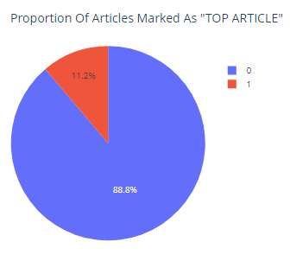
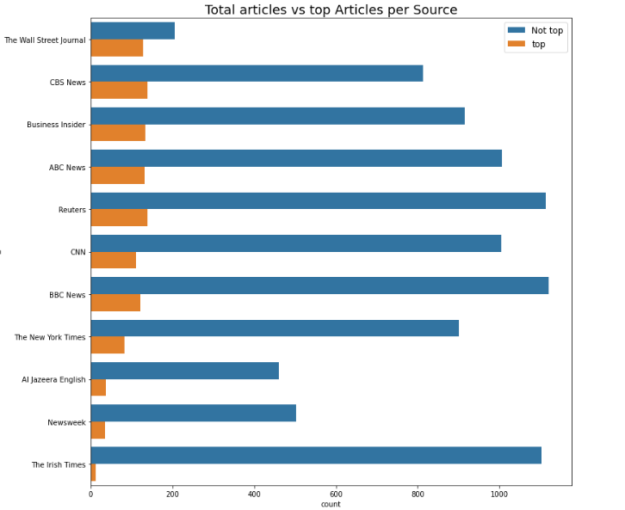
EDA-Source
Top articles are usually promoted on publisher's website and are the articles users see at the top
Only 11% of the total articles are promoted as top articles
The Wall street Journal promotes most amount articles as top as compared to others ,whereas The Irish Times has least number of top articles

Slide 7
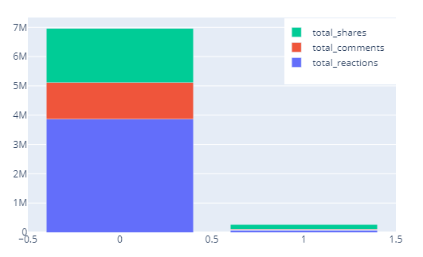
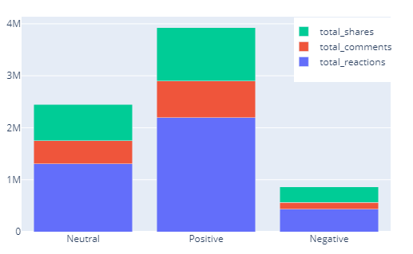
EDA-Title and Description
Effect of duplicate Title
Duplicate article popularity is far less as compared to distinct title
Effect of sentiments of the article
Sentiment of the article is also a driving factors in popularity . For example, positive articles tends to have more popularity

Slide 8
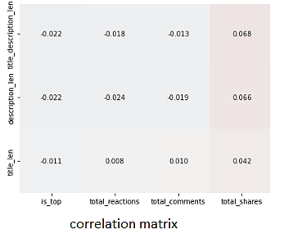
EDA-Title and Description
Effect length
The effect of length is the most evident on reaction share

Slide 9
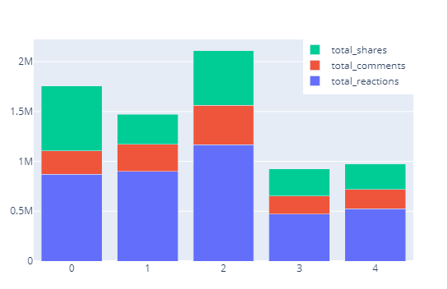
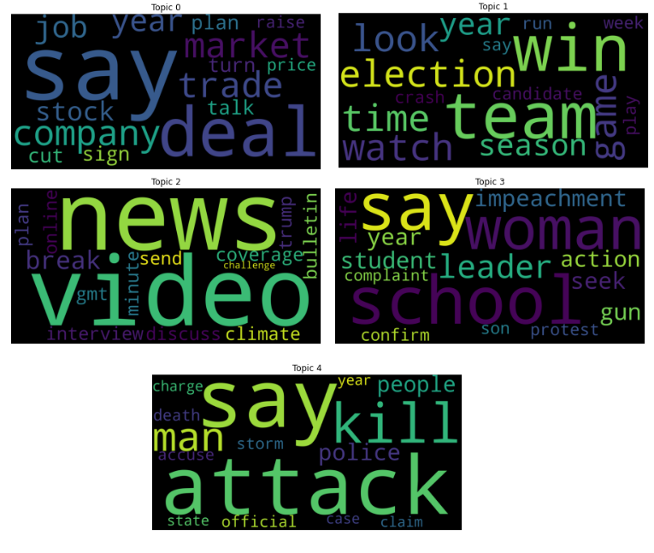
EDA-Title and Description
Topic Modeling
The topic of article also plays an important role.
Articles on current socio-political context are more popular as compared to others.

Slide 10
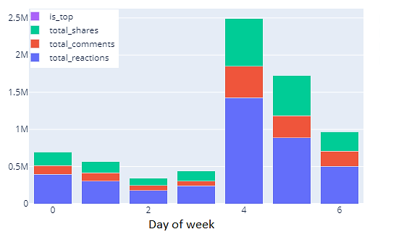
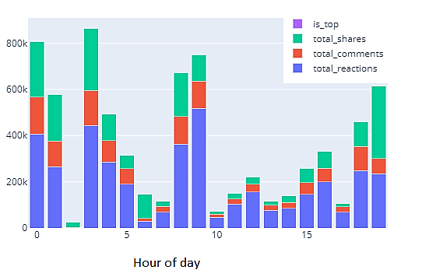
EDA-Time
The time at which article is published also plays an important role in popularity
Articles published on weekends tend to have higher popularity .
Articles published between 6pm and 5 am tend to have higher popularity .

Slide 11
Feature Engineering
Log transformation on count variables
Time variables based on publication date
Day of week , hour
Title/Description length
Sentiment based on Title + Description
Topic modelling using LDA based on Title + Description
Conversion of useful categorical features using pd. get_dummies into dummy/indicator variables.

Slide 12
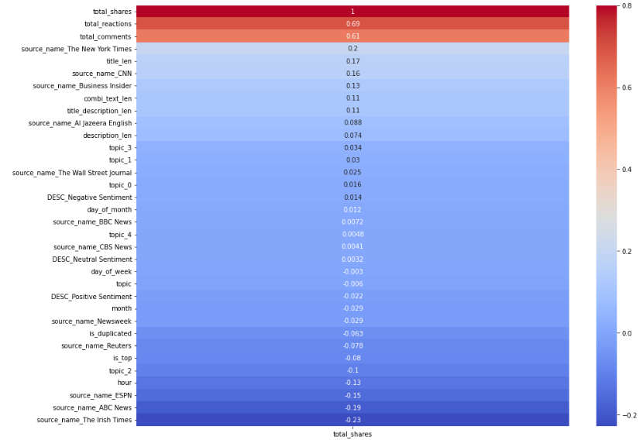
Feature Importance
Feature importance for total_shares

Slide 13
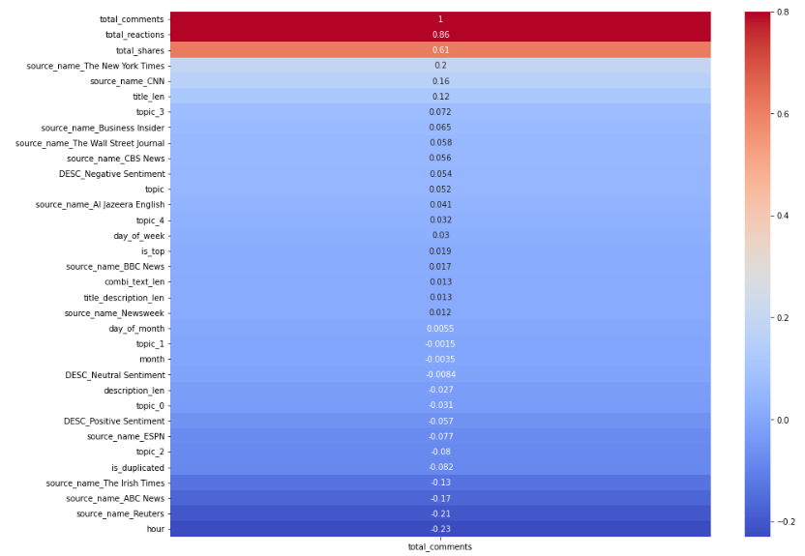
Feature Importance
Feature importance for total comments

Slide 14
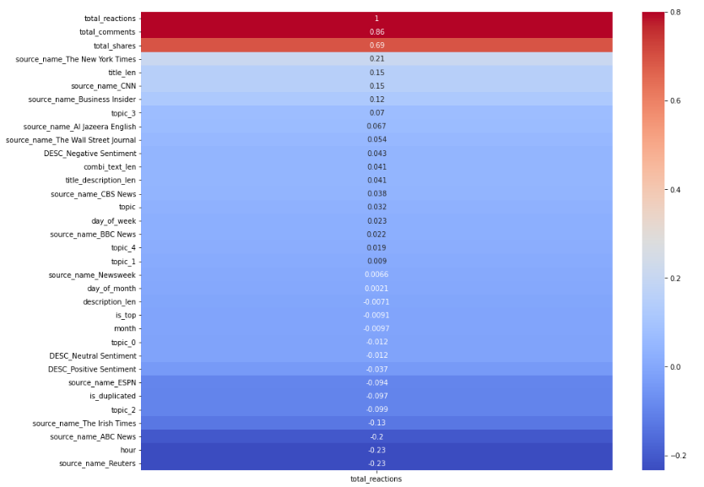
Feature Importance
Feature importance for total reactions

Slide 15
Recommendations
Rewrite negative title and descriptions
Try to make title unique
Change publication time to between 6pm and 5am
Tie story to current socio-political context and use right keywords
Use recommendation system to drive traffic from popular articles to unpopular articles

